Slide 1

HR SMART RECRUITER

Slide 2
Prepared By:
Adham Assy
Ali Salama
Mohamed Kamal
Sara Gamil

Slide 3
Presentation Agenda
Project Objective
System Architecture Overview
PDF Upload & Metadata Extraction Process
Text Splitting & Embedding using E5 Model
Vector Store Creation & Retrieval Mechanism
Question Answering using Prompt + Gemini
Candidate Summarization in JSON Format
Sample Use Case Queries
Final Results + Sample Output

Slide 4


Project Objective
Goal:
Leverage LLMs and vector databases to automate resume screening and turn unstructured resumes into searchable, structured knowledge.
Why it matters:
HRs waste time manually scanning resumes.
Valuable insights are buried in unstructured formats.
We use modern AI to extract and summarize relevant candidate data.

Slide 5

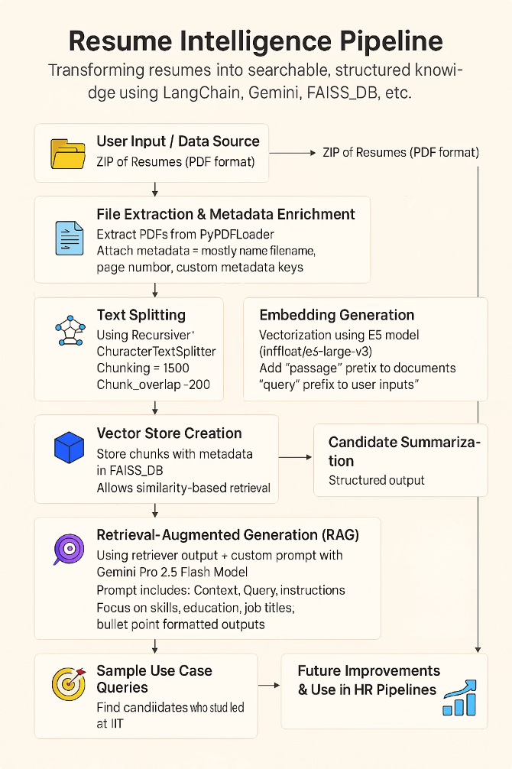






System Architecture Overview
Resume Ingestion (PDF)
Metadata Extraction & Enrichment
Embedding Generation (E5/HuggingFace)
FAISS_DB Vector Store
Retrieval-Augmented Generation (Gemini)
Output: Candidate Profiles

Slide 6





PDF Upload & Metadata Extraction Process
Upload Resumes
Extract Raw Text
Resumes are uploaded as PDFs to a designated folder.
PyPDFLoader extracts the complete text content from each PDF.
Parse Metadata
Store Data
A Metadata Tagger infers key details like name, email, and source filename.
Extracted text and structured metadata are stored together.

Slide 7
Text Splitting & Embedding using E5 Model
Why Split?
LLMs & embedding models perform better with chunked text:
More focused context for each query
Better semantic representation in vector space
Reduced token limits for processing
More precise retrieval during similarity search
Chunking Text
1
Resumes are divided into manageable, overlapping segments.
Improve LLM Performance
2
Chunking optimizes LLM and embedding model accuracy.
Embed Chunks
3
Each chunk is transformed into a vector using E5-large-v2.

Slide 8






Vector Store Creation & Retrieval Mechanism
Query Search
Similarity search (KNN) is performed on queries to identify the most relevant chunks
Store Embeddings
All embedded chunks ,along with their metadata,are stored in FAISS_DB.
Retrieve Chunks
Top relevant chunks are retrieved for further analysis, to provide context for subsequent reasoning and answer generation.

Slide 9

Question Answering using Prompt + Gemini
Retrieval QA Chain
Prompt Construction
Contextual Answers
LangChain's RetrievalQA chain handles question answering.
Prompts are crafted to guide Gemini's responses.
Retrieved chunks provide context to Gemini.
Example: "What is candidate's AI experience?"
This ensures accurate, context-aware answers.
It connects queries to relevant documents.

Slide 10
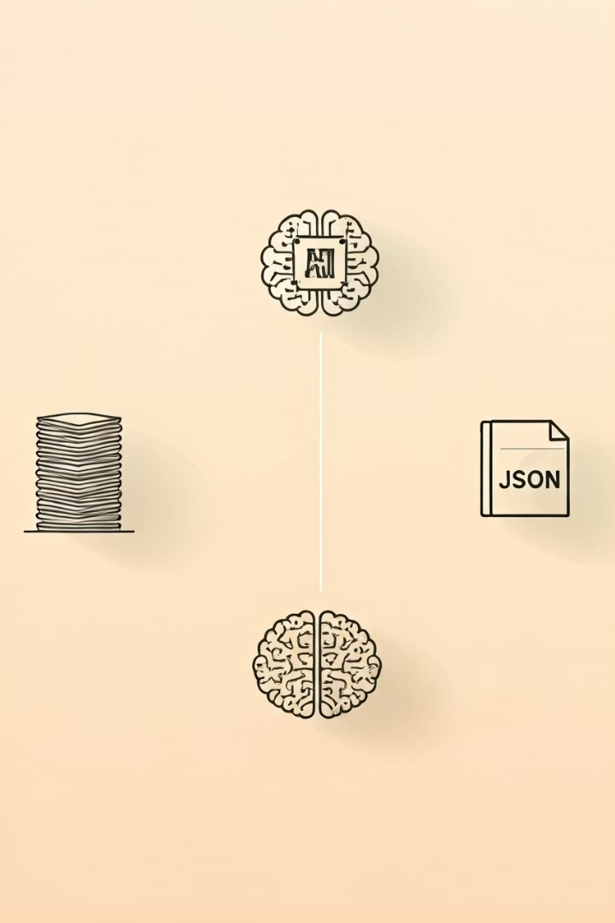
Candidate Summarization in JSON Format
1
Input Chunks
Relevant resume text chunks are fed to Gemini.
2
Gemini Processing
Gemini extracts key information from the text.
3
Output Parsers
Output Parsers ensure structured JSON output.
4
JSON Summary
A structured JSON summary is generated.

Slide 11

Sample Use Case Queries
1
2
3
University Search
Skill Match
Combined Expertise
Find all candidates from ITI university.
Identify profiles with NLP and Transformers skills.
Locate data scientists proficient in Power BI.
Recruiters can use specific queries to quickly find candidates. Examples include "List all candidates who studied at ITI," "Find profiles with experience in NLP & Transformers," and "Who has a background in data science and Power BI?". The LLM Query Engine processes these to return filtered profiles.

Slide 12
Final Results + Sample Output
Direct Answers
JSON Summaries
Queries yield clear, concise answers on screen.
Detailed JSON summaries are saved as files.
Example: "Found 5 candidates with ITI background."
They provide structured data for each candidate.
The final output includes direct answers to recruiter queries, displayed on the UI or console. Additionally, a structured JSON file containing summarized candidate information is generated and saved. This dual output provides both immediate insights and detailed, machine-readable data for further analysis or integration.

Slide 13
Thank You

